Slide 1
Interventional Radiology (IR) by Wojciech Ćwikiel MD
What is that?

Slide 2
Radiology is a medical specialty where imaging methods are used to diagnose and treat diseases within the body

Slide 3
Imaging methods used in radiology:
- X-ray images (roentgen)
computer tomography (CT)
magnetic resonance imaging (MRI)
ultrasonography (USG)
other (e.g. nuclear medical imaging)

Slide 4
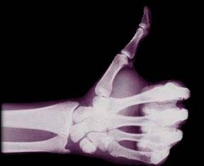
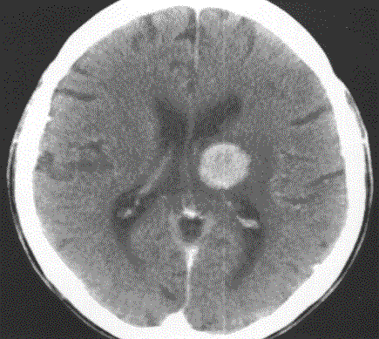
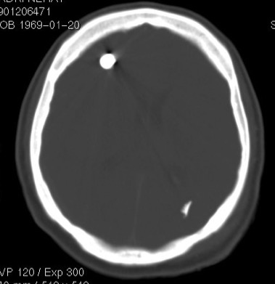
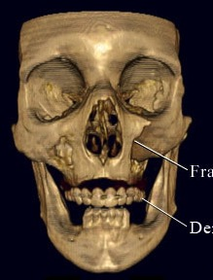
X-ray images
Computed tomography (slice roentgen)
Bleeding
Bullet
Broken bone
Unborn
CT reconstruction

Slide 5
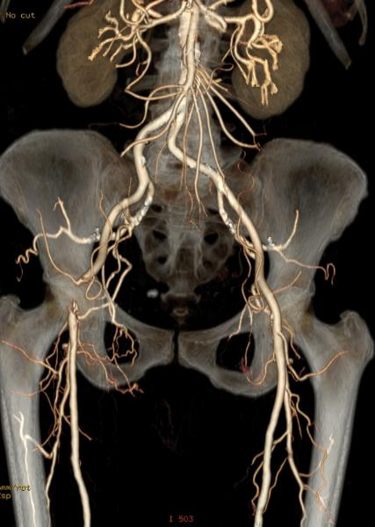
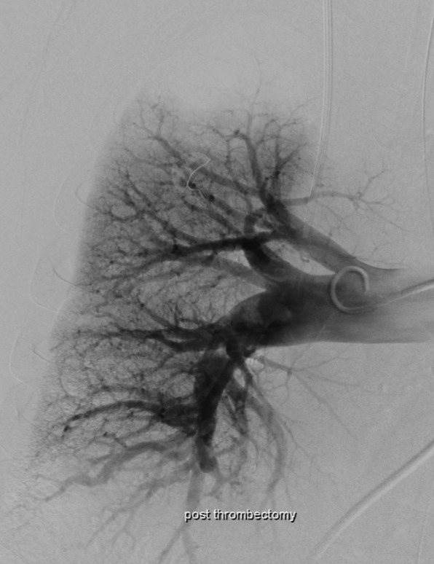
X-ray – angiography = examination of vessels (veins and arteries)
Lung arteries

Slide 6
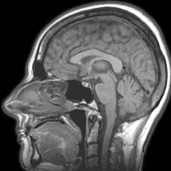
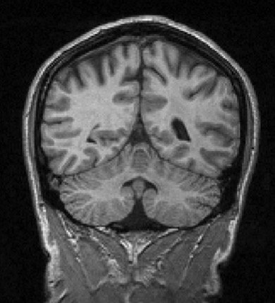
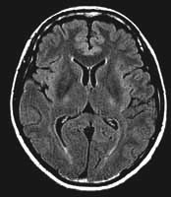
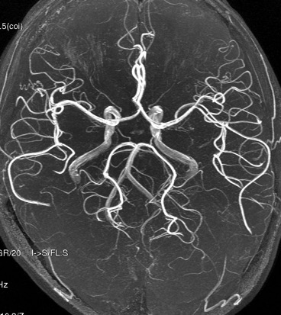
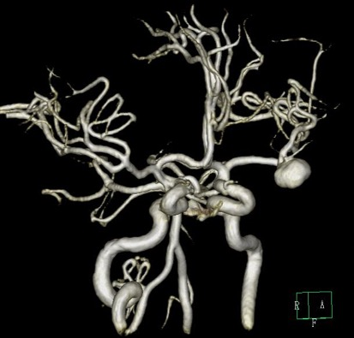
Magnetic Resonance Imaging

Slide 7
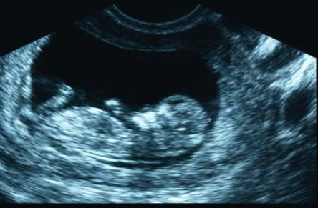
Ultrasonography (ultrasound)
unborn in uterus
stones in gallbladder

Slide 8
Medical intervention
surgery
- open surgery - e.g. take out part of the bowel
- laparoscopic (keyhole surgery) – e.g. take out gallbladder
endoscopic (small tube through the mouth or anus)
e. g. removal of a polyp from lumen of the bowel
Radiologic (with X-ray or ultrasound guidance)
e. g. insertion of a drain into the kidney
e. g. to stop bleeding by closing the artery

Slide 9
Interventional radiology (IR)
interventional procedures performed inside the body using percutaneous (puncture through the skin) techniques under imaging guidance (like X-ray fluoroscopy, ultrasonography)

Slide 10
Why IR procedure?
minimally invasive treatment of disease or symptoms
short recovery time
results superior/compatible to other methods
fewer complications
new treatment methods
possibility of repeated treatment

Slide 11
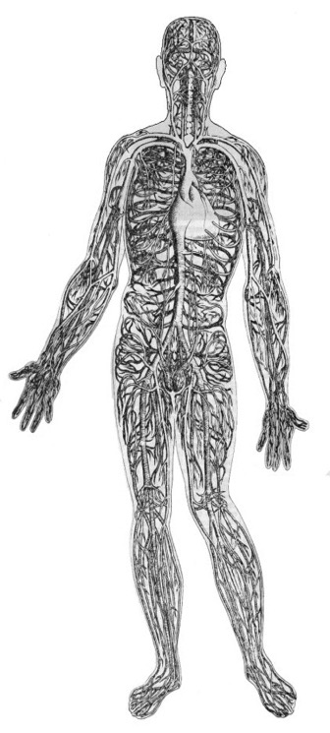
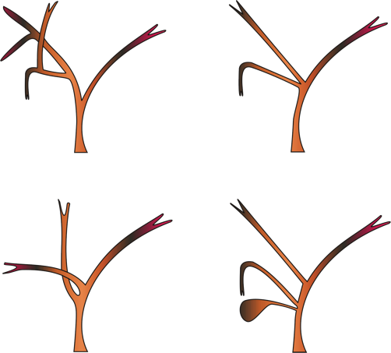
IR knowledge – anatomy (e.g.): Arteries Veins Bile ducts

Slide 12
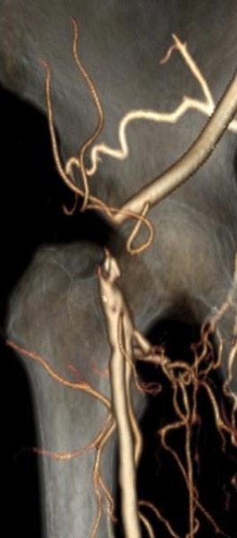
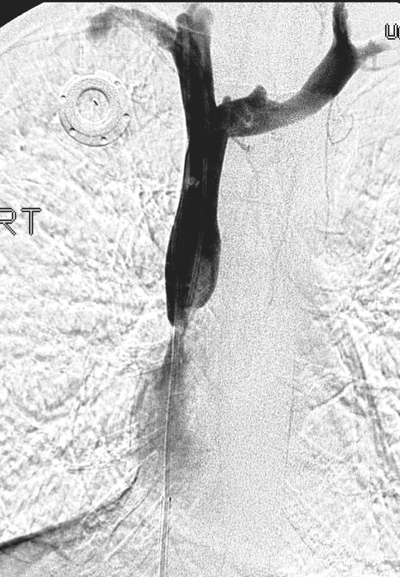
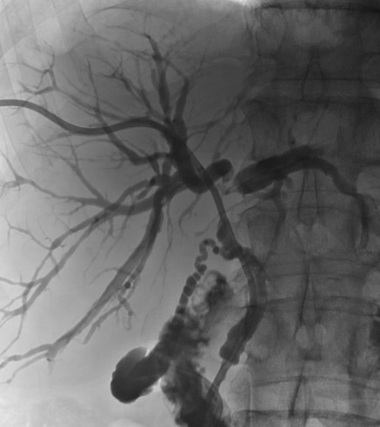
IR knowledge – pathology (disease) Stop in the artery Narrowing of the vein Narrowing of the bile duct

Slide 13
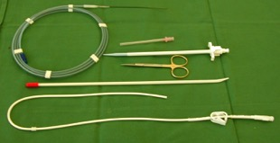
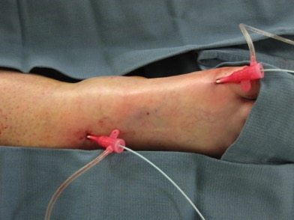
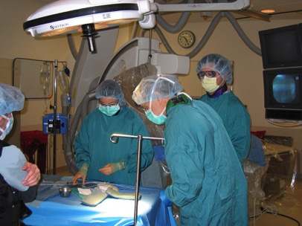
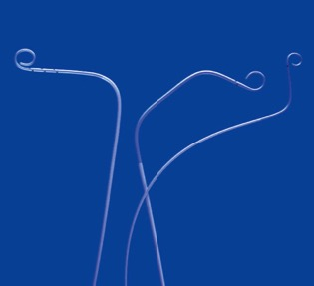
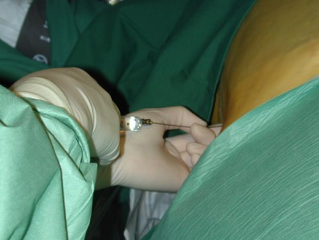
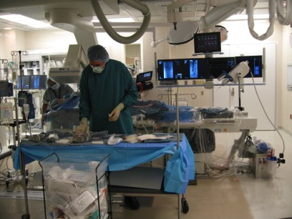
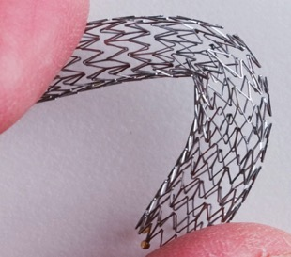
IR knowledge Materials Methods How to do it
Catheter
Stent

Slide 14
IR procedure
Local or general anesthesia
Puncture with a needle through the skin of (e.g.):
vessel (vein or artery)
bile duct
kidney - urine collecting system
fluid collection
Treatment is done through the puncture channel

Slide 15
Drainage tube placement
To drain out e.g. infected fluid collection
To take out fluid for examination
To create communication between two cavities in the body

Slide 16
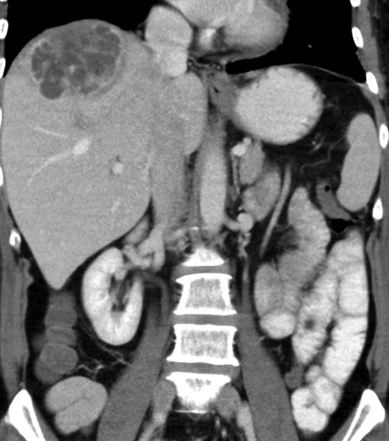
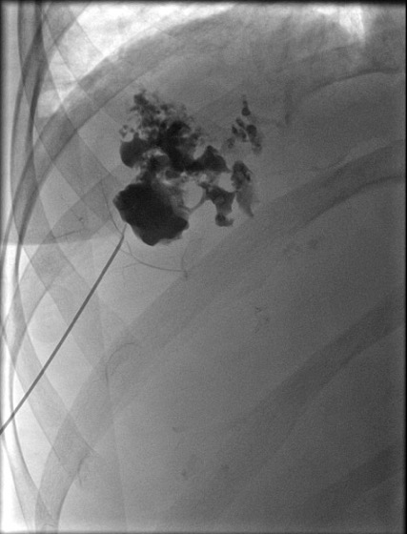
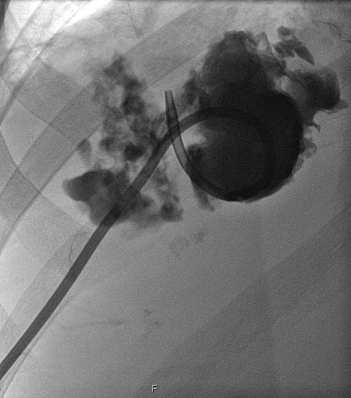
Treatment or …?
Drainage
Infected fluid collection in the liver
Puncture with a needle
Draining tube in place

Slide 17
Interventions in the artery
To reopen arteries closed by disease
To close (embolize) arteries to the tumor, bleeding etc.
Treatment of abnormal arteries (e.g. malformations)

Slide 18
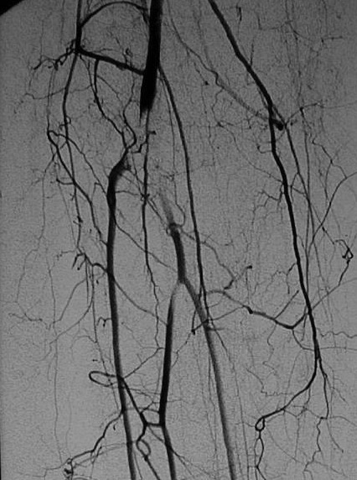
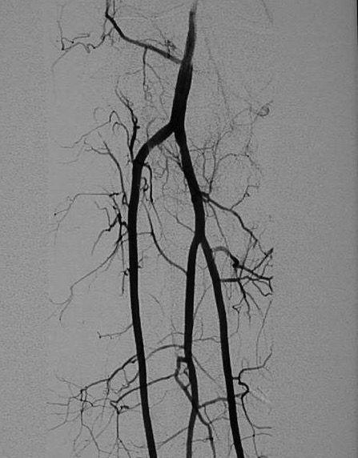
Arterial intervention
artery closed by cloth
(before treatment)
artery reopen
(after treatment)

Slide 19
Stent metal mesh cylinder - compressed may be placed through a small tube into the artery, vein, bile duct etc., thereafter is expanded to keep these structures open
artery open with
the stent

Slide 20
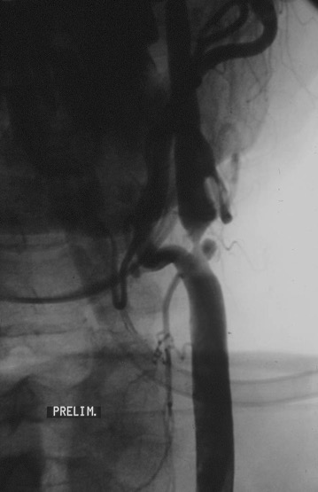
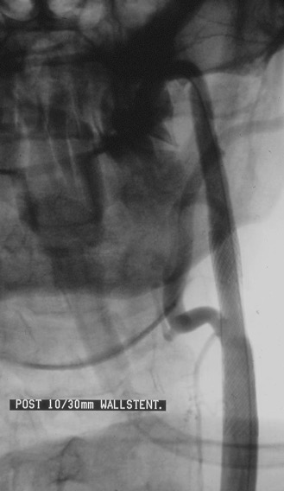
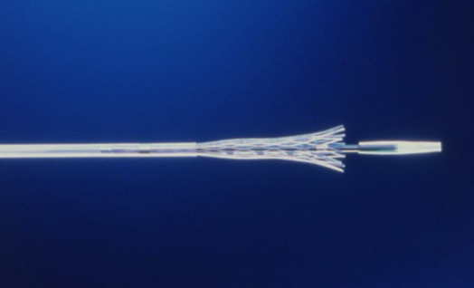
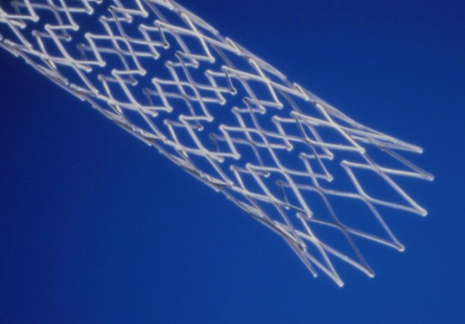
Treatment or …?
Stent-treatment of narrowing in the artery
Stent compressed
Narrowing
Stent open

Slide 21
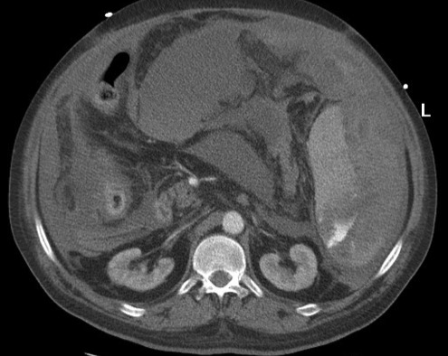
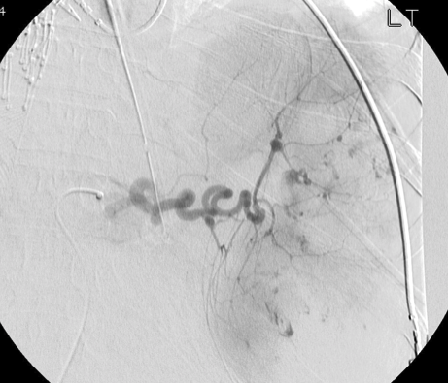
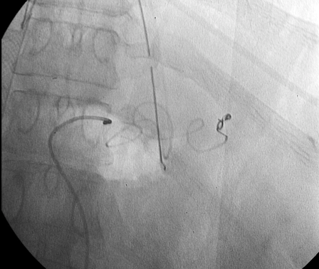
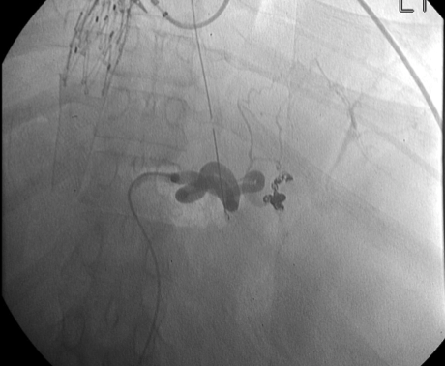
Treatment of bleeding
(placement of metal coil (spiral) through the catheter)
Coil
Bleeding from ruptured spleen
Bleeding stopped

Slide 22
Interventions in the bile ducts
Occlusive disease (bile duct is blocked)
- to drain out of the bile through a catheter (tube)
- recanalization (to open closed by disease bile duct)
- stent placement
Gallbladder
- drainage catheter placement (to drain out infected bile)

Slide 23
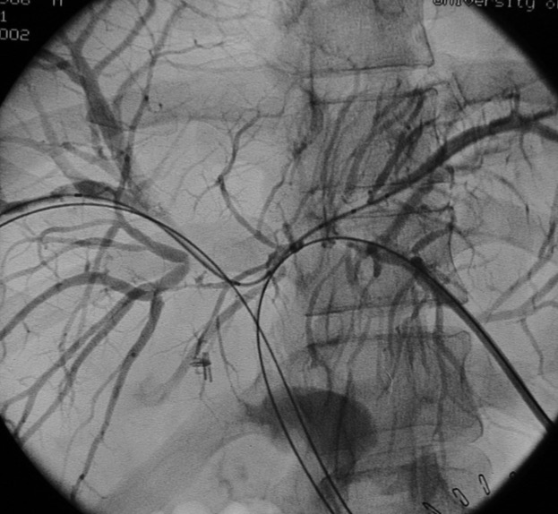
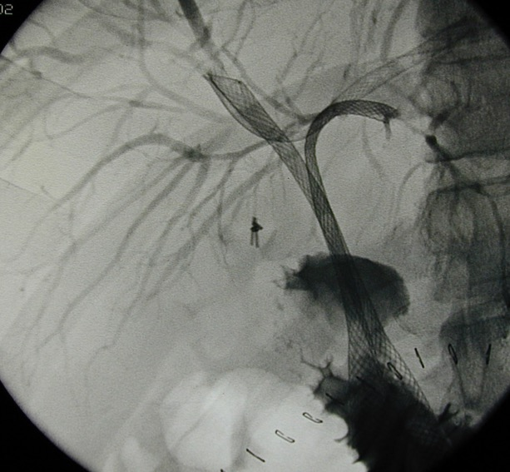
Bile duct recanalization
Bile ducts closed by tumor
Bile ducts reopen with multiple stents

Slide 24
IR procedures in liver cirrhosis
Symptoms
- bleeding from varices in esophagus/stomach
ascites (abnormal fluid collection in the belly)
IR treatment
Embolization (closure of the varices)
TIPS (new blood channel through the liver)

Slide 25
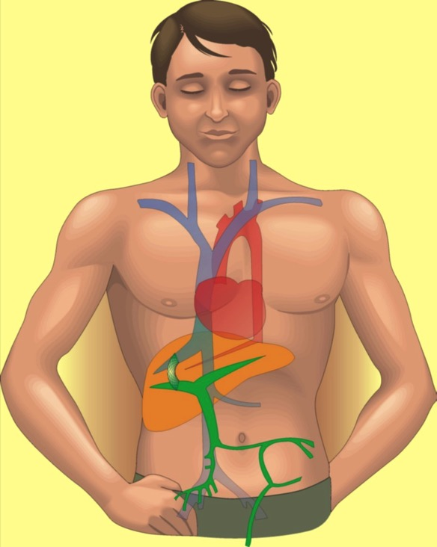
IR in liver cirrosis - TIPS
Puncture through the liver
Stent in the channel through the liver

Slide 26
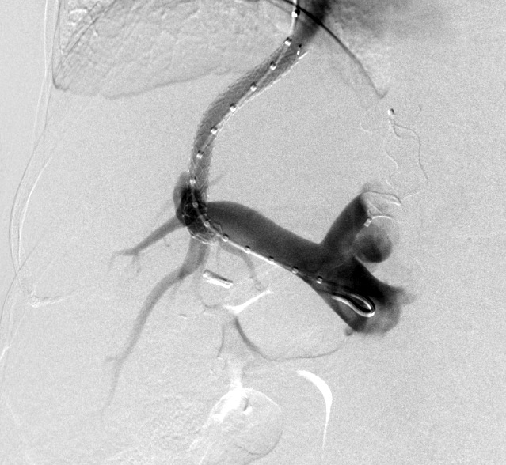
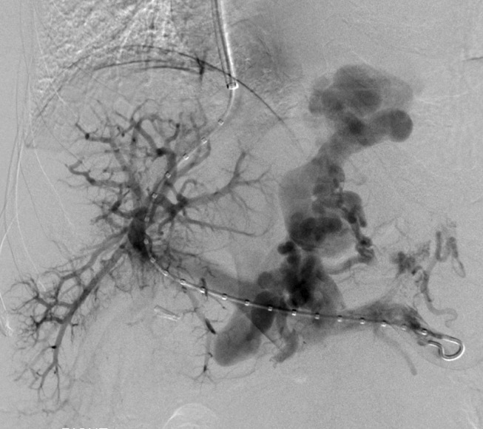
IR in liver cirrosis - TIPS
Flow through the varicose veins (before TIPS)
Flow directly to the heart (after TIPS)

Slide 27
And much, much more…...

Slide 28
I HOPE THAT IT WAS HELPFUL
THANK YOU!

